Slide 1

The Power of Data: Optimizing Automated Systems for Efficiency
Utilizing data for enhanced system performance
By Bader Abdulrahim
19-02-2025
Notes:
AI-generated content may be incorrect. --- In today's presentation, we will explore how data can be harnessed to optimize automated systems, improving their efficiency and effectiveness. By identifying inefficiencies, understanding system performance, and utilizing powerful tools like Power BI, we can create more reliable automated environments.

Slide 2
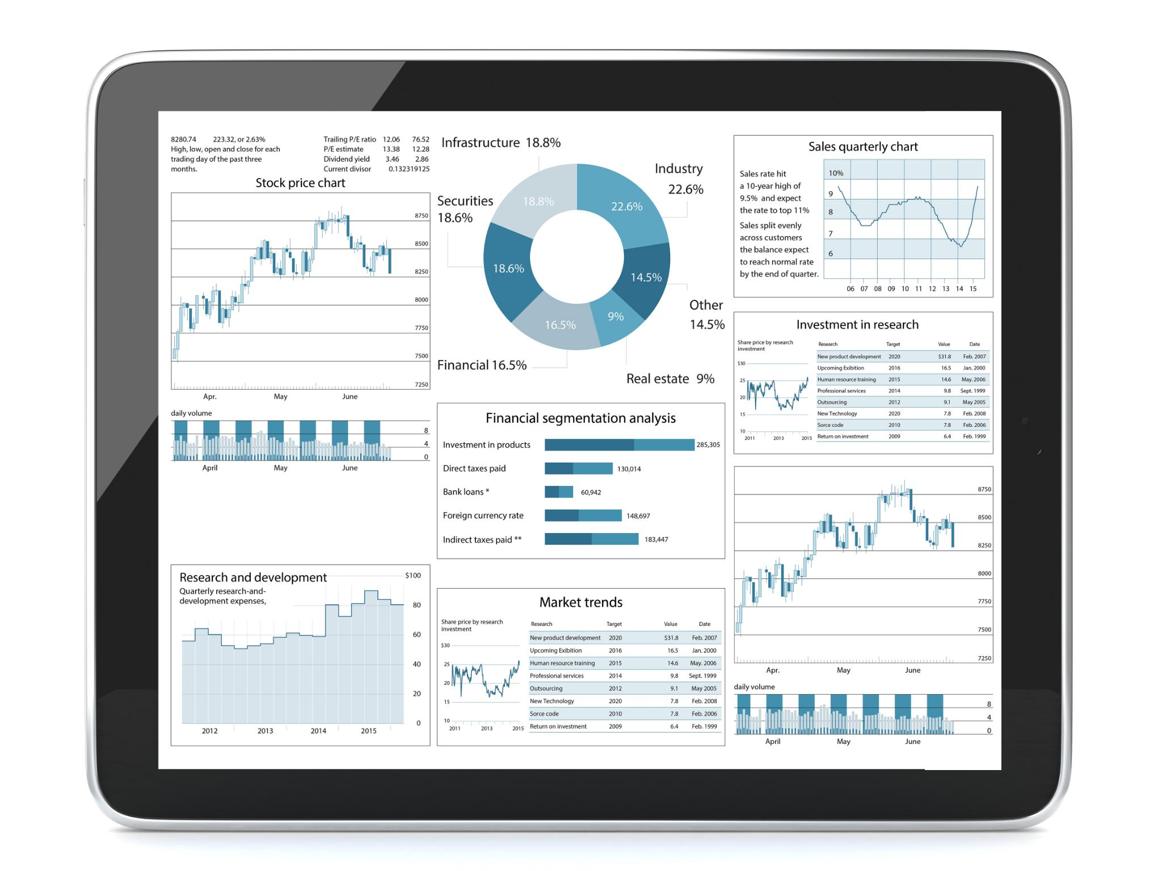
Agenda Items
Introduction.
Problem Statement
Understanding the Current System Performance
Power BI Demo 1: Performance Insights
Power BI Demo 2: Identifying Patterns and Triggers
Strategic Recommendations - Fixing the Misconfigurations
Notes:
We will begin by identifying the hidden inefficiencies in our automated systems, examining common problems such as misconfigurations and incorrect settings. Next, we will analyze the current performance of these systems using key metrics. Finally, we will demonstrate how to leverage Power BI for insights and present strategic recommendations for optimizing our systems.

Slide 3

Goals And Objectives:
Identify inefficiencies in automation, climate control, and security systems.
Find actionable insights to optimize energy usage, automation success rates, and security alerts.
Recommend data-driven fixes to reduce automation failures, minimize energy waste, and improve security accuracy.
Notes:
Many automations fail due to improper configurations. This can lead to unexpected behaviors and a diminished performance, creating a need for careful setup and regular audits to ensure optimal operation.

Slide 4
Problem Statement - The Hidden Inefficiencies
Notes:
Despite the advancements in automation, many systems face hidden inefficiencies that hinder performance. This section will address the common issues that may be causing these inefficiencies.

Slide 5
. Introduction – The Power of Data
Imagine a world where every decision you make is backed by data. No more guesswork, no more inefficiencies—just clear, actionable insights. In smart homes and businesses, automation, climate control, and security systems generate tons of data. But are we truly using it to its full potential?"
Notes:
"➡ Objective: Explain why data analytics matters in automation, energy efficiency, and security.

Slide 6
Understanding the Current System Performance
Notes:
In this section, we will look at the performance of our current systems. Understanding these metrics is crucial to addressing inefficiencies and implementing effective solutions.

Slide 7
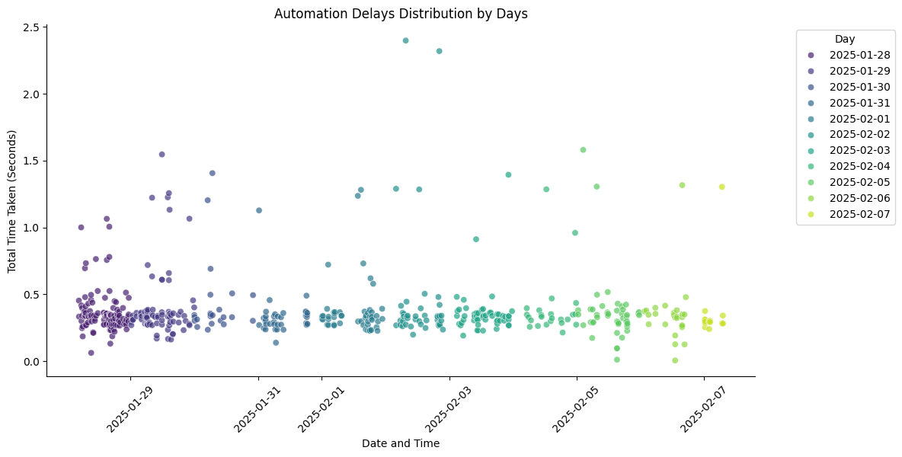
95% of the automation happen under the 1 Second

Slide 8
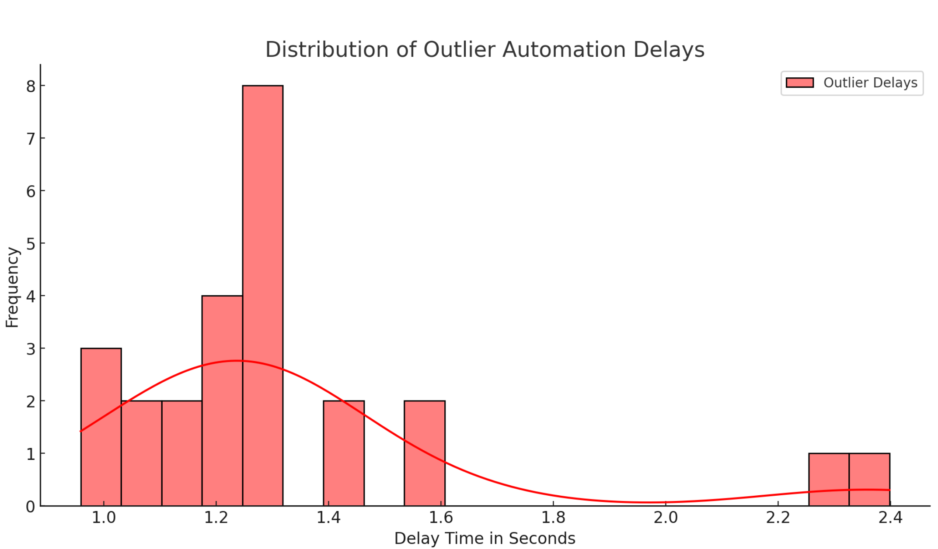

Slide 9
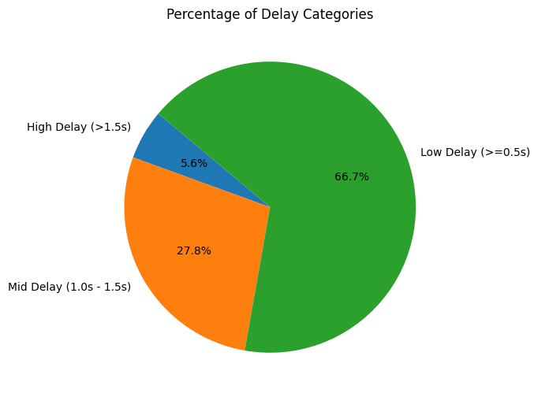
Analyzing the 5% Failure Rate in Automations
Understanding Failure Causes
Identifying specific causes of the 5% failure rate helps target areas for improvement in automation processes.
Data-Driven Adjustments
Using data analysis to make informed adjustments enhances the efficiency and reliability of automated systems.
Notes:
We'll dive into the data to understand the specific causes behind the 5% failure rate in automations. This analysis will guide us in making informed adjustments.

Slide 10
Conclusion
Understanding Performance
A clear understanding of automated systems' performance metrics is essential for identifying areas for improvement.
Addressing Inefficiencies
Identifying and addressing inefficiencies in automated systems leads to increased reliability and operational effectiveness.
Leveraging Data
Utilizing data analytics helps in making informed decisions to enhance the efficiency and reliability of systems.
Strategic Recommendations
Implementing strategic recommendations based on data analysis can lead to significant improvements in automated systems.
Notes:
In conclusion, optimizing automated systems requires a thorough understanding of their performance and addressing inefficiencies. By leveraging data and implementing strategic recommendations, we can enhance system reliability and efficiency.

